Slide 1
REAL TIME OBJECT DETECTION USING DEEP LEARNING
Submitted in the partial fulfillment for the award of the degree of
BACHELOR OF ENGINEERING
IN
COMPUTER SCIENCE ENGINEERING
Submitted by:
Chandrashekharachari
20BCS4428
Under the Supervision of:
Ms. Tanvi Mam
Department of AIT-CSE
DISCOVER . LEARN . EMPOWER

Slide 2
Introduction to Project
Object detection is a computer vision technique that involves identifying and localizing objects within an image or video. The goal of object detection is to accurately identify and locate the objects present in an image or video, and to classify them into specific categories such as people, cars, animals, and so on.
Traditional object detection methods involve manually designing features and classifiers to recognize objects in an image. However, these methods are time-consuming and require a lot of domain expertise.
Object detection is important for a variety of applications, including autonomous vehicles, security systems, robotics, and image and video search engines.
Deep learning-based approaches, particularly those using convolutional neural networks (CNNs), have been very successful in recent years and have achieved state-of-the-art performance on many object

Slide 3
Hardware Specifications: CPU – Core i5 10Gen /Ryzen 5 or above RAM – 8Gb or above ROM - 500Mb or above Web cam (either built-in or external) Software Specifications: Python Compilers (Python3 IDE) Editors (Notepad, Visual Studio Code, Code Blocks, etc.) Python packages for Image Recognition and Deep Learning Techniques
Hardware and Software Requirements

Slide 4
Problem Formulation
There has been a rapid and successful expansion of computer vision research in recent years. Part of this success can be attributed to the adoption and adaptation of machine learning methods, while others can be attributed to the development of new representations and models for specific computer vision problems, or the development of efficient solutions. Object detection is one area that has made significant progress. There are many objects in this world that humans have identified. So, this one is to make the machines recognize them. The current work provides an overview of object detection.
The goal of an object detector is to find all object instances of one or more given object classes regardless of scale, location, pose camera view, partial occlusions, or lighting conditions.

Slide 5
Objectives of the Work
Identification of all things included in an image is one of object recognition's two main goals. Filtration of the attention-seeking object.
The fundamental objective of object detection is to locate instances of each object in digital images or real-world situations, segregate them, and analyze their necessary properties for in-the-moment predictions.
For self-driving cars to get where they're going, an object identification algorithm can help automatically recognize livestock movements, traffic lights, and road lanes. As a result, drivers are no longer required for logistical missions.

Slide 6
Methodology used
Single Shot MultiBox Detection (SSD) is the algorithm which we have used to detect the objects.
It is an object detection algorithm that uses a single neural network to generate a set of predictions for the presence and location of objects in an image.
The main idea behind SSD is to discretize the output space of bounding boxes into a set of default boxes with different aspect ratios and scales, and then predict the offsets and confidences for these default boxes.
The network then combines these predictions to generate the final set of object detections.
SSD is a robust and efficient object detection algorithm that has been used in a wide range of applications, including autonomous driving, surveillance, and robotics.

Slide 7
SSD: SSD is a popular object detection algorithm due to its simplicity and speed. Since it involves a single pass of a neural network, it is faster than other multi-stage object detection algorithms like Faster R-CNN. open cv : A Python package called OpenCV makes it possible to carry out image processing and computer vision tasks. It offers a variety of capabilities, such as tracking, face recognition, and object detection. Imutils : Basic image processing tasks including translation, rotation, scaling, skeletonization, Matplotlib picture presentation, sorting contours, edge detection, and more are made simpler with OpenCV and both Python 2.7 and Python 3.

Slide 8
ARGPARSE It is simple to create user-friendly command-line interfaces thanks to the argparse module. The program specifies the arguments it needs, then argparse works out how to extract those arguments from sys.argv. Additionally, the argparse module automatically creates usage and help messages. MOBILENET_SSD An object detection model called Mobilenet SSD uses the input image to calculate the output bounding box and object class. This Single Shot Detector (SSD) object detection approach, which may provide quick object recognition tailored for mobile devices, leverages Mobilenet as a backbone.

Slide 9
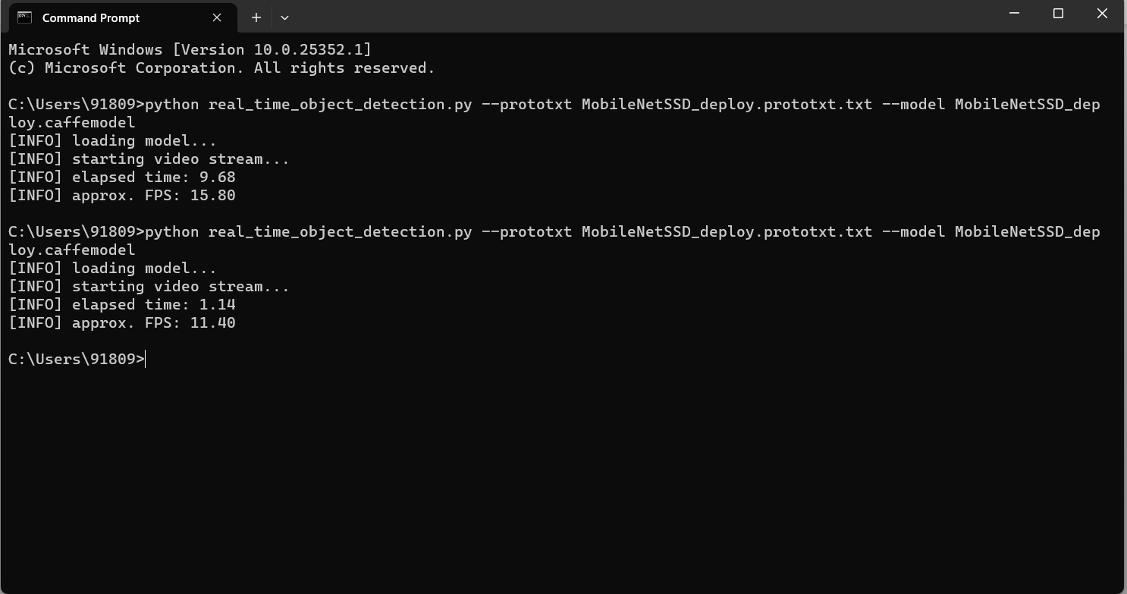
Results and Outputs
Open the command prompt and then enter the command as below :
python real_time_object_detection.py --prototxt MobileNetSSD_deploy.prototxt.txt --model MobileNetSSD_deploy.caffemodel

Slide 10
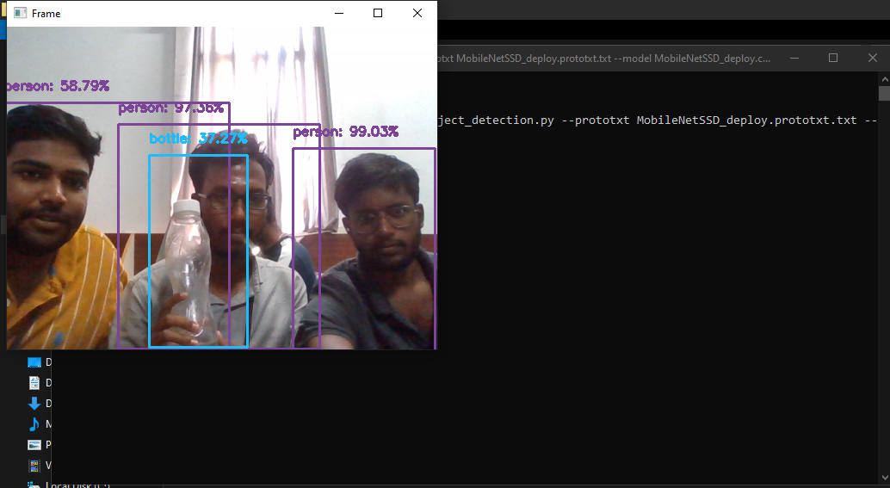

Slide 11
Conclusion
As In the modern world, object detection and recognition can be regarded as one of the most difficult, complicated, and crucial tasks in the field of computer vision. As far as we know, this project was created with the fundamental goal of capturing real-time objects in images, videos, or web cams.
One of the newest and most fascinating areas of deep learning is object recognition. Face detection is a popular use of object detection, found in almost all smartphone cameras. On multiple deep learning models capable of performing real-time object detection and recognition. By studying the performance of these algorithms on standard datasets, YOLOv3, Tiny-YOLOv3 and Faster R-CNN have been identified as the most suitable and efficient deep learning models to perform detection and recognition of real-time objects on scale engineering vehicles. It is concluded that Faster R-CNN performs on par with SSD and FCN models in terms of speed, while exhibiting better accuracy compared to these models.

Slide 12
Future Scope
As In the modern world, object detection and recognition can be regarded as one of the most difficult, complicated, and crucial tasks in the field of computer vision. As far as we know, this project was created with the fundamental goal of capturing real-time objects in images, videos, or web cams.
Future innovations can be concentrated by putting the project on a system with GPU for quicker outcomes and greater accuracy. It can be improved and innovated in the future by anyone without worrying about complexity.
For instance, MS COCO does small object detection in several face detection tasks and applications. for better small object localisation across partial barriers. In order to improve the network architecture, we will make some changes.
To achieve accurate and efficient recognition of small objects, thereby reducing reliance on data networks.

Slide 13
References
S. Murugan, K. S. Devi (2018), A. Sivaranjani, and P. Srinivasan, “A study on various methods used for video summarization and moving object detection for video surveillance applications,” Multimer. Tools Appl., vol. 77, no. 18, pp. 23273– 23290.
G. Flitton, T. P. Breckon, and N. Megherbi, “A comparison of 3D interest point descriptors with application to airport baggage object detection in complex CT imagery,” Pattern Recognition., vol. 46, no. 9, pp. 2420–2436, 2013.
Bezak, P. (2016, September). Building recognition system based on deep learning. In 2016 Third International Conference on Artificial Intelligence and Pattern Recognition (AIPR) (pp. 1-5). IEEE.
Jung, H., Lee, S., Park, S., Kim, B., Kim, J., Lee, I., & Ahn, C. (2015, January). Development of deep learning-based facial expression recognition system. In 2015 21st Korea-Japan Joint Workshop on Frontiers of Computer Vision (FCV) (pp. 1-4). IEEE.
Tenguria, R., Parkhedkar, S., Modak, N., Madan, R., & Tondwalkar, A. (2017, April). Design framework for general purpose object recognition on a robotic platform. In 2017 International Conference on Communication and Signal Processing (ICCSP) (pp. 2157-2160). IEEE.

Slide 14
www.mindwise-groningen.nl/deep-learning-the-beautiful-mind/ https://jwcn-eurasipjournals.springeropen.com/articles/10.1186/s13638-020-01826-x https://www.ijert.org/a-study-on-real-time-object-detection-using-deep-learning#:~:text=Object%20detection%20empowers%20recognizing%20instance,much%20like%20human%20vision%20works. http://www.diva-portal.org/smash/get/diva2:1414033/FULLTEXT02.pdf https://www.ijraset.com/research-paper/moving-object-detection-using-ml https://youtu.be/ATw1Dy4p1GU https://youtu.be/hMFx1TXjAJc https://youtu.be/1P6K9pVKgVo
Links

